Slide 1
COMP 143
Web Development with Adobe Dreamweaver CC

Slide 2

Dreamweaver’s Features
Create one webpage or website with many pages
Create pages with text, sound, interactivity, links
  Save files in many formats:
  HTML, XHTML, XML, CSS, JavaScript
  Create pages with
  or without coding
  Use Dreamweaver tools to organize, manage website
Notes:
Script:
Adobe Dreamweaver is a web development tool that’s part of Adobe’s Creative Cloud subscription-based service.
Adobe introduced the Creative Cloud service in 2012. In this course, you’ll learn how to use Dreamweaver to design and author websites effectively.
You can use this web development tool to create a single web page or a complex website that has many webpages. A website consists of linked webpages that share a common design and interface.
Dreamweaver allows you to create web pages that have text, sound, interactive elements, animation, video, images, and hyperlinks. You also can add forms, interactive buttons, or rollover images. Importing elements from other software programs is another option you have when using Dreamweaver.
Dreamweaver files can be saved in several formats, including HTML, XHTML, XML, CSS, and JavaScript. XHTML stands for eXtensible HyperText Markup Language, which is currently the standard language for web pages. You also can still use HTML, but it’s not considered to be the standard language anymore. Programs such as Google Chrome, Mozilla Firefox, and Apple Safari are web browsers that you can use to view your website on the Internet.
One of the advantages of Dreamweaver is that it allows you to create pages without coding. But you also can write code if you prefer. You can enter and edit code directly and then instantly see how your page looks.
You can use Dreamweaver’s organizational tools to create a website while working with a team of people. You can then manage this website using Dreamweaver’s management tools. The Files panel, for example, allows you to add pages and store your website’s files in folders.
CO1: Examine the basic features of Dreamweaver
1.1 Discuss how Dreamweaver can be used to develop a web site
1.2 Examine the features of Dreamweaver
Image: iStock #52037546

Slide 3
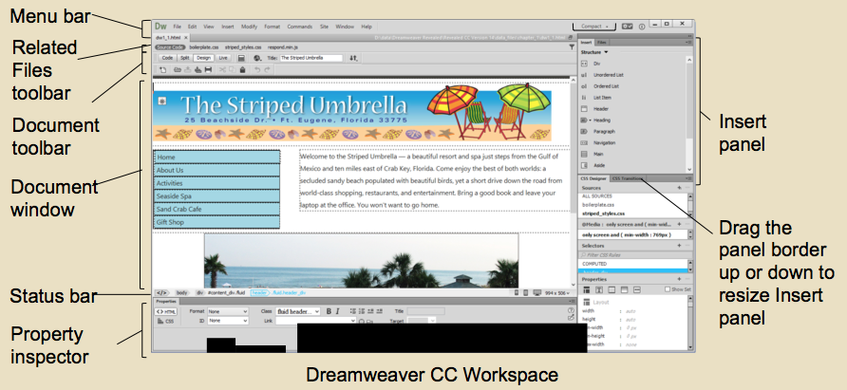
Dreamweaver’s Workspace
Workspace has panes, menus, tools to build sites:
  Document window
  Menu bar
  Insert panel
  Document toolbar
  Standard toolbar
  Related files toolbar
  Coding toolbar
  Property inspector
  Status bar
  Panel is tabbed window with related commands
Notes:
Script:
The workspace is the first screen you’ll see when you open Dreamweaver. This screen contains the panes, menus, buttons, panels, and inspectors you’ll use to create websites.
You’ll see the Document window after you create or open a new file. This is where you’ll create and edit web pages. Above the Document window, you’ll find the Menu bar, which contains menu names and application commands.
The Insert panel has eight categories: Favorites, Common, Media, Structure, Form, Templates, jQuery [pronounce: j query] Mobile, and jQuery UI [pronounce: j query U I]. You can insert objects for each category by selecting the category in the Insert panel.
The document toolbar allows you to preview web pages and view a current page in Live view, which shows the page as it would appear in a browser. The Standard toolbar has buttons for frequently used commands. The Related Files toolbar displays files that are linked to a document and necessary for that document to function and display correctly.
When you’re in Code view, you can see the Coding toolbar, which has buttons you can use to work directly in the code.
The Property inspector allows you to view and change the characteristics of an object. The status bar, located above the Property inspector, includes a tag selector that shows the HTML tags used at a selected location.
A tabbed window known as a panel contains related commands or displays information on a certain topic. Sets of related panels that are grouped together are called panel groups. A dock is a collection of panels or panel groups. You can view the content of a panel in a group by selecting a panel’s tab.
CO1: Examine the basic features of Dreamweaver
1.3 Explore the Dreamweaver workspace
Developer Notes:
Image: Chapter 1 ppt, slide 3
When the audio talks of:
“You’ll see the Document window…” fade out OST, fade in slide 3, and highlight words “Document window.”
“Above the Document window you’ll find the Menu bar…” highlight the words “Menu bar.”
“The Insert panel has eight categories…” highlight the words “Insert panel.”
“The document toolbar allows you to preview …” highlight the words “Document toolbar.”
“The Related Files toolbar displays files…” highlight the words “Related Files toolbar.”
“When you’re in Code view…” fade out slide 3 and fade in OST to sync with audio script.
“The Property inspector allows you to view…” fade out OST, fade in slide 3, and highlight words “Property inspector.”
“The status bar…” highlight the words “Status bar.”
“A tabbed window known as a panel…” fade out slide 3 and fade in OST to sync with audio script.

Slide 4
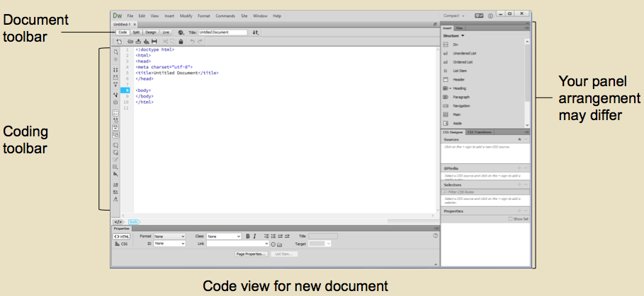
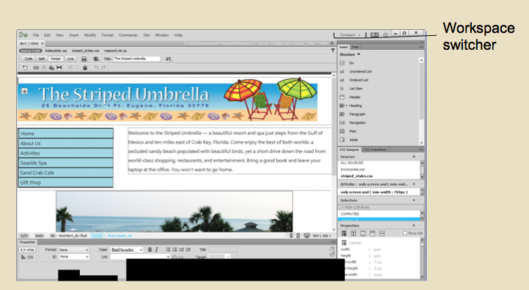
Dreamweaver’s Views
Dreamweaver has 3 views:
  Design view
  Code view
  Show Code and Design view
Use Switch Design View
to Live View to see how page will look in browser:
  Can edit in Live View
  Use Workspace switcher to change workspace layout:
  Can save new layout with new workspace name
  Return to default layout
  using Reset current view
Notes:
Script:
The way that web page content is displayed is called the view. Dreamweaver has three views.
You can see how a page is likely to appear in a browser using the Design view. You can see the HTML code for a page using the Code view. The view labeled Show Code and Design views is a combination of these two views. You can use this view to quickly debug or correct errors because you can immediately see how the page changes when you change the code.
You can get a better idea of how a page will actually look in a browser by using the Switch Design View to Live View button on the Document toolbar. This shows the page with the interactive elements active. The ability to edit pages directly in Live View is a recent improvement. For example, you can use the Insert panel in Live View to delete or add images and other page elements. Before you begin editing, you must select the Hide Fluid Grid Layout Guides button on the Document toolbar.
Dreamweaver provides an integrated workspace, which means all the panels and document windows appear in one application window. But you can use the Workplace switcher, located on the Menu bar, to change your workspace layout and save that workspace with a new name. You can return to the default layout by using the Reset current view option.
CO1: Examine the basic features of Dreamweaver
1.3 Explore the Dreamweaver workspace
Developer Notes:
Images in the order they appear on the screen:
From ppt Chapter 1, slide 15
From ppt Chapter 1, slide 3
When the audio talks of:
“You can see the HTML code for a page…” fade out OST, fade in slide 15, and highlight words “Coding toolbar.”
“The Show Code and Design views…” fade out slide 15 and fade in OST to sync with audio script.
“You can get a better idea of how a page…” fade out OST, fade in slide 15, and highlight words “Document toolbar.”
“The ability to directly edit pages…” fade out slide 15 and fade in OST to sync with audio script.
“But you can use the Workplace switcher…” fade out slide 15, fade in slide 3, highlight words “Workplace switcher.”
“You can return to the default layout…” fade out slide 3 and fade in OST to sync with audio script.

Slide 5
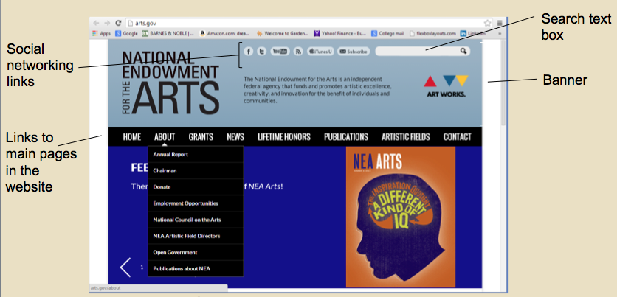
Viewing Web Pages and Using Help
Can open or create
websites or webpages
Home page is first page:
  Directs users to rest of site
  Previews site’s design
Websites can include:
  Rich media content
  Text that’s to the point
  Hyperlinks
  Banners
  Menu bars
  Use Help commands to get answers, manage account
Notes:
Script:
Once you’re in Dreamweaver, you can open or create websites or webpages.
The home page is the first page you see when you call up a website. The home page directs users to the rest of the site and previews the website’s design. Rich media content refers to the visual or interactive elements you add to your pages to make it attractive and engaging for the user. You can use Dreamweaver or other programs such as Photoshop or Illustrator to create these elements.
Web pages range from simple text-based pages to more complex pages that have such elements as movies, images, and sound. Text is the primary method of conveying information, but you should keep text short and to the point to keep users engaged. You can type text into Dreamweaver or import text from other programs. Using the Property inspector, you can then format the text to make it visually appealing.
Hyperlinks, or links, are text elements or images that send users to other locations on a page or website.
Images should be used sparingly to add visual interest to a page. You also can add banner images on the side or top of a page to add such elements as contact information or a company logo.
Menu bars, or navigation bars, have multiple links to pages on a website. These bars are sometimes used with an image map, which is an image whose sections serve as links. The navigation structure refers to the way that internal links such as menu bars are used on your website.
While working in Dreamweaver, you can use the Help menu commands to get answers to your questions, check for updates, and manage your Creative Cloud account.
CO1: Examine the basic features of Dreamweaver
1.3 Explore the Dreamweaver workspace
Developer Notes:
Image: From ppt Chapter 1, slide 19
When the audio talks of:
“The home page is the first page you see…” fade out OST and fade in slide 19.
“Rich media content refers to the visual or interactive elements…” add arrow pointing to NEA arts graphic.
“You can use Dreamweaver or other programs…” fade out slide 19 and fade in OST to sync with audio script.
“You also can add banner images on the side or top…” fade out OST, fade in slide 19, and add circle around “Banner.”
“Menu bars, or navigation bars…” add circle around “Links to main pages in the website.”
“They’re sometimes used with an image map…” fade out slide 19 and fade in OST to sync with audio script.

Slide 6

Planning a Website
First decide on goals, audience, content, design for website
Create wireframe to show site’s structure
Create local site folder
to store all site’s files
Set up site, pick name
Use Files panel to manage folders, files
Notes:
Script:
Creating a website is a complex process. It can involve working with a team of people with many roles to make sure the site is accurate, attractive, and easy to navigate.
Planning is an essential part of creating a successful website. First, you’ll need to determine the website’s goals and audience and then decide what content and design would be best for targeting that audience. Next, you’ll make a plan that includes a timeline, budget, and task list.
To begin executing your plan, you’ll create a wireframe to outline the structure of your site. The wireframe, which is similar to a flowchart, shows how the pages on a website will be linked to each other. You can draw a simple wireframe on paper or use a graphics program such as Illustrator to create a more complex version. Your wireframe will include the home page, also called the parent page. The pages that are linked to the home page are called child pages.
You also should create a folder hierarchy for your site. First, you’ll create a local site folder, or root folder, to store all of the website’s HTML files or pages. Next, you’ll create an assets or images subfolder to store sound and image files.
Once your local site folder is created, you can set up your site using the Dreamweaver Site setup dialogue box. You’ll specify the local site folder and pick a name for your site. The site’s name and folders will then appear in the Files panel, which you’ll use to manage your folders and files.
CO1: Examine the basic features of Dreamweaver
1.4 Describe how to plan a website using Dreamweaver
Image: iStock #64072565

Slide 7


Creating Pages and Publishing Site
Collect files for pages
Use Dreamweaver or software programs to
create pages:
  Limit number of elements
  View site in browsers,
  on devices to test
Publish site’s files to
remote web server:
  Server connected to
  Internet with IP address
  ISPs provide publishing space
  Use Dreamweaver’s FTP
  to transfer files
Notes:
Script:
Once you’ve set up your site, you’ll need to collect the files necessary to create your pages. These files could include text, buttons, images, animations, or video.
You can create some pages using Dreamweaver and import other pages from other software programs, such as word-processing programs. Be careful to not add too many elements to each page, as this can increase a page’s loading time by increasing its file size.
Once you’ve completed your pages, you should test that they all look good and all the links work. You should view them on various devices and through such commonly used browsers as Chrome, Firefox, Safari, and Internet Explorer. Every time you make a change to the site, you should test it again.
Publishing your site involves transferring all of the site’s files to a remote web server so users can view it online. The remote server is a computer that’s connected to the Internet with an Internet Protocol, or IP, address. This server is not connected to the computer where your local site is stored. The IP address is an assigned series of numbers that designates the site’s location online. The domain name is the site’s name written in letters rather than numbers. The domain name also is called the Uniform Resource Locator, or URL.
Internet Service Providers, or ISPs, provide space to publish sites. Some commercial sites also provide some free space to their users. You’ll use Dreamweaver’s File Transfer Protocol, or FTP, to transfer your files.
CO1: Examine the basic features of Dreamweaver
1.4 Describe how to plan a website using Dreamweaver
Image: #62555560, #58113498

Slide 8

Adding Folders and Web Pages
Create assets folder, subfolders to store files:
  Dependent files necessary for pages to function
  Related files enable functions, style content
  Use Files panel to add, move, rename, delete files
  Create blank pages to start or build full pages:
  Blank pages help determine site’s navigation early
  Name pages with keywords
  Link all pages to home page
Notes:
Script:
After setting up a website, you’ll need to create folders to organize your site’s files. You can start by creating a folder called “assets” or some other name that indicates what the folder contains. You also might want to create subfolders to store sound, image, or text files.
Dependent files are files linked to an HTML page that are necessary for that page to function. Related files are files that are used to enable functions or style the content. You can use the Files panel to add, move, rename, or delete folders and files.
Websites usually contain many pages that link back to the home page. To start building your site, you can create several blank web pages. HTML5 is the default document type when you install Dreamweaver, but you can change it to another type. You can add graphics and text to these pages after you name them. It’s important to name these pages with words that users might enter as keywords in a search engine.
Starting with blank pages helps you determine the site’s navigation structure before you add content. You also could create complete pages and link them as you build. However you proceed, you should consider how users will navigate the site. Be sure that all pages link back to the home page, for example, so users don’t have to rely on the Back button. You also should give all icons, text, and buttons used in the menu bar a consistent look across all pages.
CO1: Examine the basic features of Dreamweaver
1.5 Add folders and pages to a web site
Image: iStock #56805886

Slide 9
Creating Headings and Making Site Accessible
You’ll create headings for every page:
  Has page title, meta tags with keywords, description
  Search engines use headings to find your site
  Keywords should be short, relevant to your site
  Store POWDER for authentication
  Set page properties to make site accessible:
  Refer to Section 508, W3C accessibility guidelines to help users with disabilities
Notes:
Script:
Two factors you’ll need to consider when building your web pages are the page’s headings and properties.
The heading is composed of the page title, which appears in the browser, and meta tags, which do not. Meta tags are HTML codes that provide such information as keywords and a description. A keyword relates to a website’s content and a description outlines a site’s content and features.
Search engines compare text in page titles to the keywords typed in search engines. Some search engines limit the amount information they will include, so you should keep this text concise. You also should think about what keywords users might enter into browsers when searching for your site. Many designers use focus groups to help determine these keywords. You can store a description in an XML file to provide Protocol for Web Description Resources, or POWDER, authentication. This system evaluates web pages and helps users determine whether a site is trustworthy.
When selecting the page properties for your site, such as colors, you should consider the needs of all users. To ensure that all users can access your site, you’ll need to comply with the U.S. Section 508 accessibility guidelines. Adobe provides information on how to make your site accessible to users with disabilities.
Techniques include using text alternatives for non-text content. Adobe also has information on the Voluntary Product Accessibility Template, or VPA, which explains how Dreamweaver CC complies with Section 508. In addition, you can refer to the WorldWideWeb Consortium, or W3C’s, accessibility guidelines.
CO2: Develop a web page using Dreamweaver
2.1 Discuss how to create Dreamweaver heading content and set page properties

Slide 10
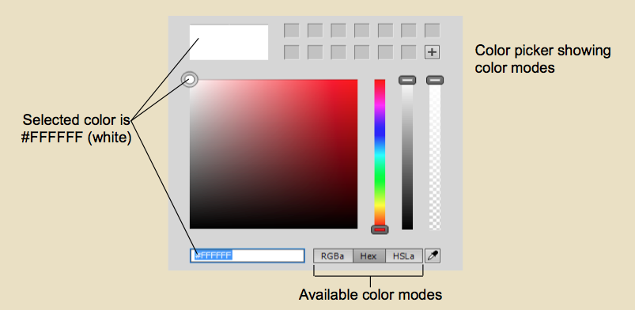
Setting Page Properties
Page design guidelines:
  Add white space
  Keep pages simple
  Give site consistent theme
  Make site easy to navigate
Cascading Style Sheets, templates give pages consistent look and feel
Start by setting colors, fonts:
  Can change default settings
  Can use RGBa, HSLa, HEX color notation schemes
  Pick contrasting colors
  to make text readable
Notes:
Script:
When creating your pages, you also should think carefully about the body of each page, which is what users will see in a browser window.
Some guidelines to consider include adding white space, or areas with no content, to keep your pages from looking cluttered. You also should keep each page simple and limit the number of media elements you use. The site should have a consistent theme and be easy to navigate as well. You can use templates and Cascading Style Sheets, or CSS, to ensure that all your pages look and feel the same. This consistency will help prevent users from getting lost in the site.
When you create a page, you’ll first set the properties that will determine how the page will look. This step includes deciding whether to change the default font and default link colors. You can use the CSS Designer panel to make your color and style choices as well as apply these choices to all of your pages. You can use the RGBa, HSLa, or HEX color notation schemes to pick colors. Note that the HEX scheme gives each color a hexadecimal RGB value. This value represents the amount of red, blue, and green in each color. “A” represents the number 10 in this numbering system and “F” represents the number 15.
As mentioned earlier, you should keep accessibility in mind when choosing colors. The Web Content Accessibility Guidelines, or WCAG, state that it’s easier for users to read your site if you have a strong contrast between the background color and the text. The guidelines also state that you shouldn’t use color as the only way to relate information, such as referring to a “red” box.
CO2: Develop a web page using Dreamweaver
2.1 Discuss how to create Dreamweaver heading content and set page properties
Image: Chapter 2, ppt slide 10
Developer Notes:
When the audio talks of:
“You can use the RGBa…” fade out OST, fade in slide 10 and highlight the words “available color modes.”
“Note that the HEX system gives each color…” add circle around words “Selected color is #FFFFFF (white).”
“You should keep accessibility in mind when choosing colors…” fade out slide 10 and fade in OST to sync with audio script.

Slide 11
Creating, Importing, Formatting Text
Most info on site is text
Can type text into Dreamweaver or import from software programs
More common to use CSS for styles than HTML tags:
  Can change page content without affecting formatting
Stick to standard fonts
Use Property inspector to:
  Apply CSS styles
  Pick fonts, font sizes
  Format blocks of text
Notes:
Script:
While page settings such as color are an important component of your website, you’ll primarily be using text to present information.
As discussed earlier, you can type your text into Dreamweaver or import it from a software program such as Microsoft Word. Using the Import Word Document command will preserve the formatting and create clean HTML code, which is code that doesn’t include unnecessary instructions. You also can create a link from your page to a Word or Excel document.
It used to be more common to format your text using HTML tags. You can still use tags, but the accepted approach now is to use CSS styles. This approach separates the content from the styles, which are placed in the page heading or in an external style sheet file. This separation allows you to change or update page content without affecting formatting. You’ll use the Property Inspector to apply CSS styles, which will be discussed in more detail later.
When formatting text, it’s best to stick to standard fonts. This increases the chance that users will have those fonts on their computers. Standard fonts also work well on both Macintosh and Windows computers. You also can use TypeKit, which provides access to web fonts called Adobe Edge Web fonts that can be read correctly by all browsers and devices.
You can apply several fonts by choosing a font combination, or set of font choices, from the Property inspector’s font list. This combination ensures that if one font is not available, the browser will choose the next font on your list.
You also can use the Property inspector to change the font size or to format blocks of text as paragraphs or headings. You can use it to align or indent paragraphs as well, but it’s considered to be a better practice to use CSS styles for this task.
CO2: Develop a web page using Dreamweaver
2.2 Explain how to create, import, and format text

Slide 12
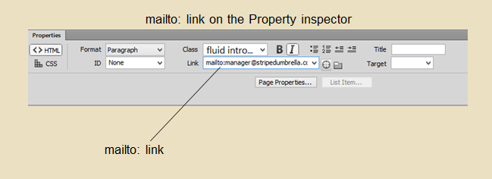
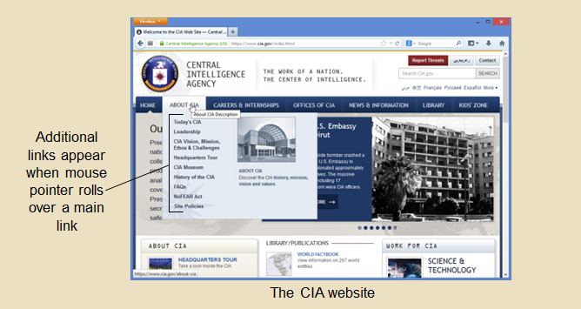
Adding Links to Pages
Links allow users
to navigate websites:
  Select item to use as link
  Specify path in Link text box
  Avoid broken links
Add contact link:
  Mailto:link is email address
Put menu bar in same place on every page:
  Rollovers show more links
WCAG link guidelines:
  Limit links, make readable
Notes:
Script:
Links, or hyperlinks, are what make it possible for users to navigate your site to view all of its pages. Visitors appreciate navigation that is easy to use. They also like websites that have links to other interesting pages or sites.
When adding links, you’ll first select an image or text you want to use as the link. Next, you’ll specify a path to the page you want to link to in the Link text box in the Property inspector. Be sure to avoid broken links, which are links that can’t find the intended destination. Typing a link address incorrectly is one way to cause a broken link.
In addition to page links, you also should add a point of contact link. This link gives users a way to contact someone associated with the site. The mail to link, which is an email address, is a common way to provide this contact information.
As mentioned earlier, menu bars provide links to the rest of your site. To help users move around your site easily, you should put the menu bar in the same place on each page. Menu bars often include rollovers, or links that appears when users move a mouse pointer over them. You also should consider such WCAG accessibility guidelines as making sure links are readable and limiting the number of links per page.
CO2: Develop a web page using Dreamweaver
2.3 Add links to web pages using Dreamweaver
Images: in the order they appear on the screen, from Chapter 2 ppt slide 26; Chapter 2 ppt slide 29
Developer Notes:
When the audio talks of:
“In addition to page links, you also should add a point of contact link…” fade out OST, fade in slide 26, and circle the Link mailto:manager@stripedumbrella.com.
“As mentioned earlier, menu bars…” fade out slide 26, fade in slide 29, circle the rollover links.
“Selected color is #FFFFFF (white).”
“You also should consider such WCAG…” fade out slide 29 and fade in OST to sync with audio script.

Slide 13
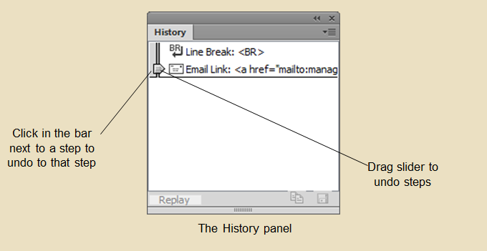
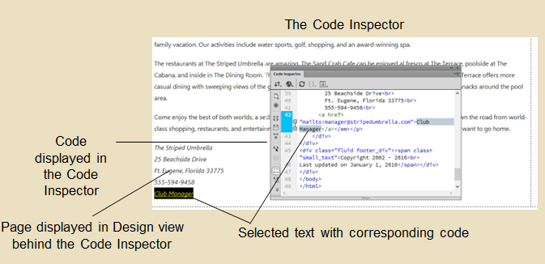
Making Changes to Pages
History panel tracks formatting, editing steps:
  Use to redo, undo steps
  Use to combine several
  tasks into one command
Keyboard shortcuts
also redo, undo steps
Can change code
in Code Inspector:
  View code in one window, Design view in another
  Add JavaScript functions
  for interactive forms, rollovers
Notes:
Script:
You have several options for making—and correcting—changes as you build your pages.
The History panel keeps track of all of your formatting and editing tasks. It lists all of these changes as steps. If you make a mistake, you can use the panel’s slider to redo or undo a step. The panel also allows you to combine several tasks into one command to speed up your work. Twenty steps are recorded by default, but you can set this number higher. Just be aware that a higher number may affect Dreamweaver’s performance by requiring more memory.
Keyboard shortcuts are another quick way to make changes. In Windows, Control-Z lets you undo a step and Control-Y allows you to redo a step. The Mac commands are Command-Z to undo a step and Command-Y to redo a step. Note that if you clear the History panel, you’ll reset the memory for the shortcuts and they won’t work anymore.
You may find that you’d like to make some changes by writing the code. As discussed earlier, you can view the code in the Code view or the Code and Design view. Another option is the Code Inspector, which allows you to see the code in one window and a full-screen view of your page in Design view in a separate window.
You also can use the Code Inspector to add such features as JavaScript functions. These functions are blocks of code that add such dynamic elements as interactive forms or rollovers.
CO2: Develop a web page using Dreamweaver
2.4 Use the Dreamweaver History panel
2.5 Describe how to edit Dreamweaver code
Developer notes:
Images in the order they appear on the screen:
Chapter 2 ppt slide 34
Chapter 2 ppt slide 38
When the audio talks of:
“The History panel keeps track of all of your formatting…” fade out OST, fade in slide 34, and highlight words “drag slider to undo steps.”
“The panel also allows you to…” fade out slide 34 and fade in OST to sync with audio script.
“Another option is the Code Inspector…” fade out OST, fade in slide 38, highlight “Code displayed in the Code Inspector” and then “Page displayed in Design view behind the Code Inspector.”
“You also can use the Code Inspector to add…” fade out slide 38 and fade in OST to sync with audio script.

Slide 14
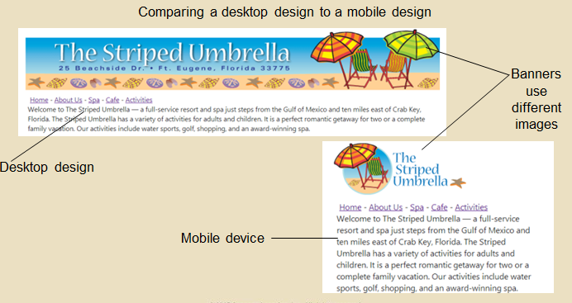
Testing and Modifying Pages
Need to keep testing after making changes
Add info to all pages even if not complete
Test different views:
  Use Preview Debug button to view site in browsers
  Use Desktop, Tablet, Mobile buttons to view site on different screen sizes
  Responsive Design,
  Media Queries allow control of page size
Notes:
Script:
Your website is never really done because you’ll always have corrections and additions to make. You’ll also need to keep testing your pages after you make these changes. Note that while you may have seen under construction pages online, you should provide at least enough information to make it worth visiting if you have a page in progress.
Previewing a page in a web browser or in Live view is the best way to test it. You’ll be able to see whether your text and images look the way you want them to. You also should check for broken links.
As mentioned earlier, you should test how your site will appear in multiple browsers and on multiple devices. You can use the Preview Debug button on the Document toolbar to add browsers to use for your tests.
You can use the Desktop size, Tablet size, and Mobile size buttons on the status bar to test how your site will appear using different screen sizes. Screens today typically have a resolution above 1024 [pronounce: 10-24] by 768.
Most sites today use Responsive design, which means that style sheets are used to determine how pages will appear on different devices. You can use Dreamweaver’s Fluid Grid Layouts to control the size of your page elements so you can have different layouts for different devices. You also can use Media Queries, which identifies which device is being used and then applies the code that will provide the best view on that device.
You’ve reached the end of the Unit 1 presentation. In this presentation, you’ve examined Dreamweaver’s basic features and learned how to develop a web page using Dreamweaver.
CO2: Develop a web page using Dreamweaver
2.6 Modify and test Dreamweaver web pages
Developer notes:
Images: Chapter 2 ppt , slide 44
When the audio talks of:
“You can use the Desktop size, Tablet size, and Mobile size buttons…” fade out OST, fade in slide 44 , and circle the words “Desktop design” and “Mobile device.”
“Screens today typically have…” fade out slide 44 and fade in OST to sync with audio script.

